Slide 1
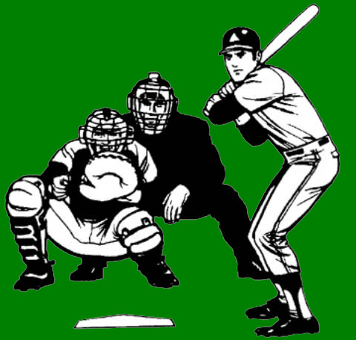
Always Remember…
Timing
Let the play happen
Communicate
Face the ball
Turn with the ball
Watch the ball
Glance at the runners
Five things that will help now, and as long as you umpire
Notes:
Always remember…
Timing
Let the play happen
Communicate
Face the ball
Turn with the ball
Watch the ball
Glance at the runners
Five things that will help now, and as long as you umpire

Slide 2
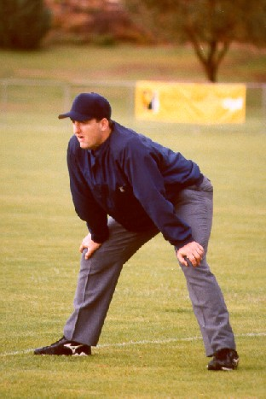
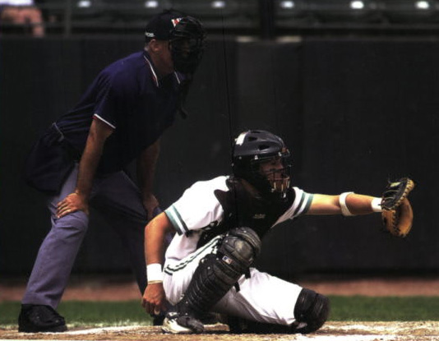
Umpire
Positions

Slide 3
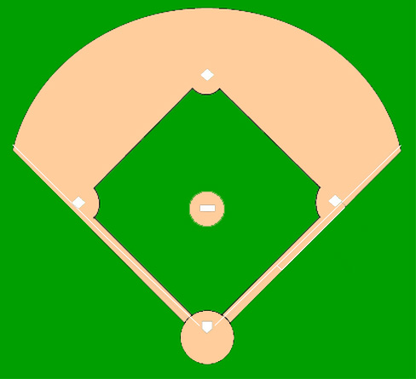
A-Position—No Runner(s)
(10-15 Feet)
Umpires
Fielders
Batter/Runner
Notes:
No Runners:
The base umpire should be about 10-15 feet behind the 1st basemen (A-position) with both feet in foul territory.
If the 1st baseman is playing at the edge of the outfield grass, 5 feet behind him is good enough.
Allow him to react to the ball without running into you. If the 1st baseman is playing even or in front of the bag, 15 feet is fine. Let him go first, then you move accordingly.

Slide 4
A-Position—No Runner(s)
(~ 5 Feet Behind First Baseman)
Umpires
Fielders
Batter/Runner
Notes:
No Runners, Left handed batter, 1st & 2nd basemen playing deep and ground ball hit to right side of the infield:
Fair/Foul Responsibilities: Plate Umpire makes the call up to the bag and the Base Umpire makes the call if the ball passes first base.
Base Umpire:
The base umpire should be about 5 feet behind the 1st baseman (A-position) with both feet in foul territory.
Hold your position until you see who is going to field the ball and who will be covering the bag at 1B.
Then move to a position in fair territory (still deep relative to first base) that will give you a clear view of the play at 1B.
If the ball is overthrown at 1B and the plate umpire calls you off as the runner goes for 2B, you must stay with the ball and rule on whether it remains in play or not.
Plate Umpire:
Move to the left side of the plate and then up the first base line.
Be ready to rule on interference/obstruction if the pitcher covers the bag at 1B. Also, be ready to get into position to make a call at 2B if the ball is overthrown at 1B and the Base Umpire is unable to get inside the baseline ahead of the runner.
If you take the runner to 2B you must communicate that to your partner.

Slide 5
B-Position—Runner on 1st Base
Umpires
Fielders
Batter/Runner
Notes:
Runner on 1st:
The base umpire moves to the infield (B-position) positioning himself on a tangent running from home plate to the edge of dirt circle around the pitcher's mound, about halfway between the mound and 2nd base.
Be square to home plate.
You have sole responsibility for a pick-off attempt at 1st base and share responsibility for balks.

Slide 6
C-Position—Multiple Runners
Umpires
Fielders
Batter/Runner
Notes:
Runner(s) on 2nd or 3rd, 1st & 2nd, 2nd & 3rd, and bases Loaded:
Move to the 3rd base side of the mound, (C-position), tangent to the dirt circle but just in front of the edge of the grass in front of the baseline.
You have the same responsibilities as with one man on 1st plus pick off plays at all occupied bases.
Note: We always work in the “B” position when there are runners on 1st and 3rd only no matter how many outs there are.

Slide 7
Ball to 3rd Base
90°
Umpires
Fielders
Batter/Runner
Notes:
Ball to 3rd baseman (routine play)
Base Umpire:
Is responsible for the play at 1st
You try to maintain a 90 degree angle on all plays
Watch the ball halfway across the infield, then bring your eyes to the bag and get in a set position, square to the bag(15-20 feet is ideal)
Watch the 1st baseman’s foot and the runner's foot, then listen for the ball to hit the glove
Plate Umpire:
Is responsible for the ground rules on the overthrow at 1st
He comes out from behind the plate, watching the ball, and moves up the 1st base line inside the foul line
Watch the throw across the field and stop in a standing set position for the play at 1st
In case of an overthrow, the plate umpire should react toward foul territory with the path of the overthrown ball and rule on whether the ball goes out of play or not.
Watch the runner to be sure he does not interfere with the play at 1st base. Also, be ready to assist your partner regarding whether the first baseman had his foot on the bag or not if asked by your partner.

Slide 8
Ball to Shortstop
90°
Umpires
Fielders
Batter/Runner
Notes:
Ball to shortstop (routine play)
Base Umpire:
Same as Ball to 3RD Base
Plate Umpire:
Same as ball to 3RD Base

Slide 9
Ball to 2nd Base
Umpires
Fielders
Batter/Runner
Notes:
Ball to 2nd baseman (routine play)
Base Umpire:
Is responsible for the play at 1st
When ball is hit to the right side of the infield, move directly toward the fielder, come to a stop, watch him field the ball and throw it. Let the throw turn you toward first base.
Watch the 1st baseman’s foot and the runner's foot, then listen for the ball to hit the glove.
Plate Umpire:
Same as for balls hit to the left side of the infield

Slide 10
Imaginary Box
Umpires
Fielders
Batter/Runner
Notes:
Ball hit in the imaginary box
Base Umpire:
Step just a few steps into fair territory to see the play and make the call. If the ball gets by the 1st baseman you will have to really hustle to get inside the diamond and be in position to make a call at 2nd base.
Plate Umpire:
In this area, the plate umpire has the fair/foul call for both the baselines, plus whether or not the batter/runner is in the 3-foot running lane
If the batter/runner is hit with the throw to 1st, it is the plate umpires call
The plate umpire has to be careful that he does not overrun the original play on the ball
If he does, he is then in a position where he could possibly be hit by the throw

Slide 11
2nd Base—1st Base
(15-20 Feet)
Umpires
Fielders
Batter/Runner
Notes:
2nd base, 1st base
Base Umpire:
Move off the line 2-3 steps into fair territory, 15-20 feet from the base
If the pitcher covers 1st base, make sure your eyes return to the ball in the pitcher’s possession after he touches the base to make sure he has control of the ball
Plate Umpire:
Move up to the 45-foot line to observe the play and be ready for an overthrow

Slide 12
Overthrow at 1st Base
Umpires
Fielders
Batter/Runner
Notes:
Overthrow at 1st base
Base Umpire:
Get your 90 degree angle to call the play
When you see the ball go by the 1st basemen, react immediately by moving into the infield
You will either pivot and take the batter/runner into 2nd base, or have an angle on a tag play at 1st if the runner breaks for 2nd and then goes back to 1st
Also moving toward the infield will get you out of the way of the runner if he just rounds the base at full speed
Plate Umpire:
On a play at 1st come up the line to watch the play
As the ball is overthrown, react to the ball toward the out of play area so you can see if it enters a dead ball area.
Both umpires should be watching the ball and be able to call the play, however the plate umpire has primary responsibility.

Slide 13
Single: Left Field Line—No Runners on Base
Umpires
Fielders
Batter/Runner
Notes:
Single on left field line
Base Umpire:
Responsible for the batter/runner touching 1st base and all plays attempted on the batter/runner
Move into the infield, watching the ball and pivot approximately 3-feet inside the infield grass
Move in to the infield and complete your pivot before the batter/runner reaches 1st base. Do not try to time your pivot to when the batter/runner touches first because if he is fast and decides to go to 2nd you will be behind the runner going into 2nd
Be in the infield moving toward second, glance back to see the batter/runner touch 1st, then continue watching the ball
When the batter/runner stops and goes back to 1st react back to first with him. You should also be ready to move with him if he decides to go to 2nd.
Plate Umpire:
Has the fair/foul, catch/no catch call on the line
Move up the line as far as the play will allow you
Be set for play, make the call
Make sure to straddle the line for the fair/foul call

Slide 14
Double or Triple: Left Field—No Runners on Base
Umpires
Fielders
Batter/Runner
Notes:
Double or Triple to left field
Base Umpire:
Your mechanics are the same as for the single to left field accept that you must move with the batter/runner all the way to 2nd and/or 3rd. In either case once the runner rounds 1st, find the ball and let it take you to the next call.
Plate Umpire:
With no runners on, you have the catch/no catch call on fly balls hit to left or center fields. Move down the 3rd base line as far as the play allows, maintaining an angle so that you can clearly see if the ball is trapped or not. Be set for the play. Rule on the play if necessary, then move back into foul territory and be ready to move into position for a play at the plate if one develops.

Slide 15
Double: Right Field—No Runners on Base
Umpires
Fielders
Batter/Runner
Notes:
Double to right field
Base Umpire:
Has catch/no catch (and if Ball is on the line, fair/foul)
The plate umpire takes the runner to 2nd and/or 3^{rd,} and the base umpire must get back to cover home
As soon as you see there is no trouble with the ball in the outfield head home in foul territory while continuing to watch the ball
When the base umpire is actually in position to call a play at the plate, then he should communicate to his partner “I got home”
Plate Umpire:
Move out from the plate with the runner
Cut a little closer to the mound on an extra base hit
Glance at the runner touching 1st base, be ahead of him into 2nd, and then beat him into third
Always watch the ball

Slide 16
Single: Center Field—No Runners on Base
Umpires
Fielders
Batter/Runner
Notes:
Single to center field
Base Umpire
Get inside the diamond quickly, complete pivot before the batter/runner reaches 1st base. Watch him touch the base and then turn to find the ball. Glance back at the runner and be ready to move to 1st or 2nd base.
Plate Umpire
Move down the 3rd baseline and maintain an angle to allow you to see any play that is made on the ball. Do not run directly at the ball.

Slide 17
Triple: Left Field—No Runners on Base
Umpires
Fielders
Batter/Runner
Notes:
Triple to left field
Base Umpire:
Same coverage as for a double to left field except now you have the batter/runner all the way to 3rd.
Plate Umpire:
Same coverage as for a double to left field

Slide 18
Extra Bases: Right Field—No Runners on Base
Umpires
Fielders
Batter/Runner
Notes:
Extra Bases to right field (RF moving toward foul line)
Base Umpire:
Has catch/no catch (and if ball is on the line, fair/foul)
When you go out on the ball, you stay out to make sure that the ball does not become lodged or go out of play. Once the fielder throws the ball back in to the infield you hustle back to home plate in foul territory while continuing to watch the ball.
When the base umpire is actually in position to call a play at the plate, then he should communicate to his partner “I got home”.
Plate Umpire:
Move out from the plate with the runner
Cut a little closer to the mound on an extra base hit
Glance at the runner touching 1st base, be ahead of him into 2nd, and then beat him into 3rd
Always watch the ball
You must also be ready to make a call at the plate if the runner goes and your partner is unable to get there. The runner is your responsibility all the way around the bases unless your partner calls you off at the plate.

Slide 19
Single: Right Field—No Runners on Base
Umpires
Fielders
Batter/Runner
Notes:
Single to right field
Base Umpire:
When you decide to go out on a ball,signal to your partner by raising your left arm that you are going out. Yelling your partner’s name and telling him that you are going out is also helpful. DO NOT yell, “ I have the ball.” That can confuse the players.
Let the ball turn you onto the foul line
Take the fair/foul, catch/no catch on the ball
Assume a standing set position, straddling the line for the play
Remember once your out you stay out until the ball is thrown back in
Don’t come back into the infield and be too close to a play at 1st
Plate Umpire:
Take the batter/runner
Move out from the plate, watching the ball, and split the difference between the pitcher’s mound and 1st base
This puts you ahead of the runner
As the batter/runner reaches 1st base, glance over to see him touch it
When the batter/runner stops and goes back to 1st base, go back with him. If he continues on you move with him and be ready to make the call at any base.
Once all play has stopped, stay with the runner until the base umpire returns to the infield and assumes responsibility for him

Slide 20
Single: Right Field Line—No Runners on Base
Umpires
Fielders
Batter/Runner
Notes:
Single to right field line
Base Umpire:
Take the fair/foul, catch/no catch on the ball
Let the ball turn you onto the foul line
Assume a standing set position, straddling the line for the play
Remember once your out you stay out
Don’t come back into the infield and be too close to a play at 1st
Plate Umpire:
Take the batter/runner
Move out from the plate, watching the ball, and split the differences between the pitcher’s mound and 1st base
This puts you ahead of the runner
As the batter/runner reaches 1st base, glance over to see him touch it
When the batter/runner stops and goes back to 1st base, go back with him
Stay with the runner until the base umpire returns to the infield and assumes responsibility for him

Slide 21
Pickoff—Runner on 1st Base
Umpires
Fielders
Batter/Runner
Notes:
Pickoff at 1st, runner on 1st first base only
Base Umpire:
When the pitcher begins his move to 1st move toward the 45 foot line to give yourself an angle at 1st
You are only going to get 1-2 steps so don’t try to get too much
The important thing to remember is to be set for the play
The steps are:
Pivot or open up with the left foot then step across (square up) with the right
Observe the play
Make the call
Plate Umpire:
Move to the 1st base side of home plate and watch the play
Do not turn away from the pitcher too quickly and miss a possible balk
You have the ball on the overthrow
Do not remove your mask unless there is an overthrow

Slide 22
Steal—Runner from 1st to 2nd Base
Umpires
Fielders
Batter/Runner
Notes:
Steal – runner on 1st
Base Umpire:
On a steal play the base umpire will see the man on 1st break
Stay with the pitch, stand up, see the ball clear the batter (watch for possible check swing), turn and pinch in towards 2nd with the throw
Open you body with the right toe pointing to the base and cross-step towards 2nd base keeping your body open to the throw
Take the throw over your shoulder, letting the ball turn your head into the base
Be set for the play and don’t call it too soon
Make sure the fielder holds onto the ball after the tag, and/or the runner stays in contact with the bag
Let the play happen
Plate Umpire:
Call the pitch and watch for batter interference
Step out from behind the catcher and batter and watch the play
Batter interference has priority over watching the play at 2nd base
Stay with the action in the plate area until it is fully completed
After the play has finished, signal the new count to your partner

Slide 23
Overthrow on Pickoff—Runner on 1st Base
Umpires
Fielders
Batter/Runner
Notes:
Overthrow on pickoff at 1st
Base Umpire:
Stay ahead of the runner
Plate Umpire:
Move out to the right side to see if the ball goes out of play (remove mask)

Slide 24
Overthrow on a steal—Runner on 1st Base
Umpires
Fielders
Batter/Runner
Notes:
Overthrow on steal – runner on 1st
Base Umpire:
As soon as the ball goes by the fielder, move toward 3rd, watching the ball
If the runner goes, stay with him
If he breaks and then goes back to 2nd, go back with him
If you cannot beat the runner into 3rd, fight for an angle and get set for the play
Plate Umpire:
Stay at home, should the runner try to score on an overthrow at 3rd base

Slide 25
Pickoff—Runner on 1st & 2nd Base
Umpires
Fielders
Batter/Runner
Notes:
Pickoff at 1st, runners on 1st & 2nd base
Base Umpire:
You have the play at 1st base
It’s basically the same as a pickoff attempt at first base with a runner on 1st only
The difference is that you take a step or two directly toward 1st base which opens up the angle automatically
Stay aware of what the lead runner is doing
If there is a second play, watch the ball and let it take you to the play
Plate Umpire:
Step out and watch the play
You have the ball on the overthrow but do not stray too far away from the plate because of the possibility of the lead runner coming home on the play

Slide 26
Pickoff—Runner on 2nd Base
Umpires
Fielders
Batter/Runner
Notes:
Pickoff at 2nd, runners on 2nd base only
Both Umpires:
Have the same responsibilities as a pickoff at 1st and an overthrow on a pickoff
The plate umpire won’t have to go with an overthrow into centerfield
He can stay at home and watch the ball

Slide 27
Steal at 2nd—Runners on 1st & 3rd Base
Umpires
Fielders
Batter/Runner
Notes:
Steal at 2nd – runners on 1st & 3rd base
Base Umpire:
The basic movement is the same as a steal of 2nd base from a runner on 1st base only except you should fade back a little closer to the mound
The important thing to remember with a runner on 3rd is to make sure the catcher throws the ball to 2nd
It is better to be a step short on the tag play at 2nd, than to be 80 feet from a close tag play at third
Plate Umpire:
Call the pitch and watch for interference on the batter, and step out from behind home plate
Stay at home for possible play at the plate

Slide 28
Steal at 3rd—Runner on 2nd Base
Umpires
Fielders
Batter/Runner
Notes:
Steal at 3rd – runner on 2nd base only
Base Umpire:
As the pitch is delivered, listen to determine if the runner is breaking to 3rd base
If he does break, take a couple of steps toward home, watching the pitch to the plate
Watch the throw into 3rd and let it turn you into the play
In a double steal situation (runners stealing second and third at once), don’t break with the runner going to 3rd
Take a few steps toward the plate (this will put you in a better position to react if the throw goes to 3rd), make sure where the ball is going, then react
Do not get into a foot race with the runner stealing 3rd
Fight for an angle by moving toward an imaginary 45-foot mark on the 3rd base line
Get set and make the call
Plate Umpire:
Duties are the same as in the other steal situations

Slide 29
Runner—1st to 3rd on hit to Right Field
Umpires
Fielders
Batter/Runner
Notes:
Runner 1st to 3rd
Base Umpire:
With runner on 1st, you are responsible for the runner touching 2nd and the batter-runner touching 1st
When the ball goes to the outfield, turn with the ball and center yourself near the back of the mound
As the outfielder comes up throwing the ball, the base umpire should react to 2nd base if the ball is thrown directly to the base
If the outfielder throws directly to 1st base, react directly to 1st base
As the outfielder comes up throwing to a cutoff man, break to a point on the “track” halfway between 1st and 2nd base
As you break to the “track” let the ball turn you
If the ball is cutoff, let the throw take you to 1st or 2nd base
If the throw goes to 3rd base, the plate umpire has the responsibility for the runner to 3rd base
The most important thing to remember is to watch the ball
It will take you to the right place
Plate Umpire:
The runner advancing from 1st to 3rd base is your responsibility
The plate umpire should move about ¾ of the way up to 3rd base in foul territory
If you have:
Ball and Runner – Move into the 3rd base – cutout and communicate to your partner “I’VE GOT 3RD! I’VE Got 3RD!”
Ball – Maintain your position ¾ of the way up the 3rd base line in foul territory—Continue to face the ball. If there is a play at 3B, get set in fair territory to make the call.
Runner only – Go home and communicate to you partner “I’M GOING HOME! I’M GOING HOME!”

Slide 30
Fair/Foul, Catch/No Catch–Plate Umpire Runner 1st to 3rd
Umpires
Fielders
Batter/Runner
Notes:
Runner 1st to 3rd – Fair/Foul Catch/No Catch for Plate Umpire
Ball on 3rd base line:
Base Umpire:
Move from B to C position
Watch the runners touch 1st and 2nd. Listen for your partner to say, “I’ve got 3rd!”. When you hear that just point in his direction with your left arm to let him know that you heard him. Turn your attention to the batter/runner and the ball and move into position to make a call at 1st or 2nd if necessary.
If your partner does not let you know that he has 3B, then steal a look to see if he is going to be there. If not, you must move to a position near the back of the mound so that you can rule on both runners.
Plate Umpire:
As the ball is hit up the 3rd base line, get to the line, stay on the line and continue to the 3rd base area (3/4 of the way)
Plate umpire has fair/foul, catch/no catch call
If there is a play on the runner at 3B, move into fair territory, shout “I’ve got 3rd!”, get set, and make the call.

Slide 31
Double Play—Runner 1st, ball hit to 2nd Base
Umpires
Fielders
Batter/Runner
Notes:
Double Play—Runner 1^{st,} ball hit to 2nd Base
Base Umpire:
Step up with the foot on the side that the ball is hit (Shortstop - right foot, 2nd base - left foot)
Step up and turn with the ball
As the ball gets to 2nd base, watch the play
If the ball is bobbled or the play is slow in developing then get in the set position to make the call at 2B.
If the play is made cleanly and there will be a play at 1B then make the call at 2B while moving toward the pitcher’s mound and 1B.
Let the throw to first turn your head and body square to 1B and make the call.
If the runner at 2B was safe, go back toward 2B and sell the call by again indicating that he was safe.
Plate Umpire:
Move toward the 3rd base side of the mound and watch the play at 2nd base for the interference (force play slide rule)

Slide 32
Double Play—Runners 1st and 2nd ball hit to 2nd Base
Umpires
Fielders
Batter/Runner
Notes:
Double Play—Runners 1st and 2nd ball hit to 2nd Base
Base Umpire:
The mechanics for Base Umpire are the same as the previous page with the following exception: If the play at 2nd base is slow in developing, you need to be aware that the fielder could decide to throw to 3rd base. If this happens move toward the mound, look at your partner to make sure only one of you is going to make the call. If he is there let him make the call. If not, you have to make this call too!
Plate Umpire:
When the ball is hit move down the 3rd base line and observe the force play slide rule action at 2B. Continue down the line in foul territory while keeping your eyes on the baseball. If there is a throw from 1B to 3B, move in to fair territory and get set to make the call at 3B.

Slide 33
Double Play—Runners 1st and 2nd ball hit to 3rd Base
Umpires
Fielders
Batter/Runner
Notes:
Double Play—Runners 1st and 2nd ball hit to 3rd Base
Base Umpire:
Move from the “C” position towards the mound and let the ball take you to your 1st call. If the fielder tags 3B, rule on that play but keep your eyes on the ball. Let the fielder’s throw take you to your next call. If he throws to 1B, take a few steps toward 1B while watching the ball. Get set before the ball gets to 1B and make the call.
If the fielder throws to 2B after tagging 3B, let the throw turn you toward 2B, get set, and make the call.
Plate Umpire
When the ball is hit move in foul territory down the 3B line. Watch for force play slide rule action whether the 1st play is made at 3B or 2B.
If the play goes to 3B and then to 1B, be in a position to make the call at 3B if the runner from 1st tries to go all the way to 3B.

Slide 34
Reverse Double Play—Runners 1st ball hit to 1st Base
Umpires
Fielders
Batter/Runner
Notes:
Reverse Double Play—Runner 1^{st,} ball hit to 1st Base, No Force
Base Umpire:
As the 1st baseman fields the ball move a little toward 1st
As soon as he has control of the ball and is moving towards the bag, start back towards 2nd base
Watch the first baseman touch the base and call the play at 1st on the move
This should leave you open to the throw to 2nd and ahead of the runner. Remember the runner must be tagged since the force is off.
Watch the ball and get set for the play
If the ball is hit softly to the 1st baseman, he bobbles the ball, or if the pitcher has to cover 1st, odds are against a play at 2nd
In that case, react to 1st base because that should be your only play
Plate Umpire:
Get to the 1st baseline for the fair/foul decision
Make sure of the call and watch for interference at 1st base
With runners on 1st & 3rd, if a reverse double play occurs with one out, the plate umpire must be alert to a possible time play and be able to get back to the plate for a call there.

Slide 35
Tag Play—Runners on 1st & 2nd
Umpires
Fielders
Batter/Runner
Notes:
Runners at 1st and 2nd
Base Umpire:
You have responsibility for runners tagging at 1st and 2nd, or 2nd base only
On fly balls to right field, move back toward the mound to maximize your peripheral vision so that you can see the catch and the tag by the runner(s).
After the catch, glance at the runners
If they tagged legally, they will still be near the base at that time.
It is very important that you know if the outfielder actually caught the ball (i.e. voluntary release, etc)
As the ball is then thrown from the outfield, watch the ball and let it take you to your next call.
If the ball is thrown to 2B, simply step toward 2B and make the call.
If the throw goes to 3B, watch the ball and the runner moving between 1st and 2nd. Be ready to make a call on him if the throw is cut off or there is a play on him after the play at 3B.
With runner on 1st base only, the runner will go halfway to 2nd on a ball hit to the outfield
Center yourself behind the mound, see the catch and drift toward 1st base
Plate Umpire:
With runners on 1st & 2nd, move up the 3rd base line
As you see the runner(s) go back to tag, communicate to your partner: “I’VE GOT 3RD IF HE COMES!”
If the runner at 2nd goes to 3rd, yell: “I’VE GOT 3RD I’VE GOT 3RD!” as you move into the cutout at 3rd for the play
***Remember*** If the fly ball to the outfield is dropped, the plate umpire should immediately communicate “I’m GOING HOME!” “I’m GOING HOME!” so that the base umpire knows that he has plays at 3B as well.

Slide 36
Tag Play—Bases Loaded
Umpires
Fielders
Batter/Runner
Notes:
Tag Play—Bases Loaded
Base Umpire:
Move toward the mound so that you can see the catch and the runners tag-up at 1st and 2nd
You have all tag-ups at 2nd and 1st and all plays on the bases
Let the ball take you to your play
Plate Umpire:
Move deeper into foul territory so that you can see the catch and the runner tag-up at 3rd base
You have the tag-up at 3rd and the play at the plate

Slide 37
C-Position—Infield In
Umpires
Fielders
Batter/Runner
Notes:
“C” Position Infield In (Bases Loaded)
Base Umpire:
Position yourself behind the infielders and behind the runner at 2B so that you are out of their way.
Signal to your partner that you are working deep
If the ball is hit on the ground to an infielder move inside if possible and let the ball take you to the play. You have responsibility for the initial call at 1st, 2nd, or 3rd.
If the ball is hit in the air, move inside, pick up the flight of the ball, and position yourself to see the runners tag up at 1st and 2nd. If the ball is in the “V”, the catch/no catch call belongs to you.
Plate Umpire:
When your partner is in this position remind yourself that you will not be able to get help from him on line drives in the infield since all infielders are in front of him.
You are responsible for the runner tagging up at 3B on fly balls and may have to expand your fly ball coverage if your partner is unable to move into position.
You still have responsibility for force play slide rule action.

Slide 38
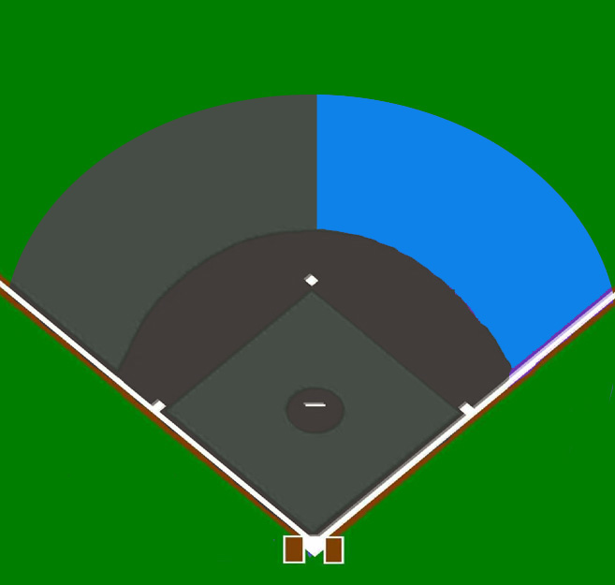
Fly Ball Coverage—No Runners
Base Umpire
Plate Umpire
Notes:
No runners on Base
Base Umpire:
You have responsibility for fly balls in the outfield from straight away centerfield to the rightfield out of play boundary.
For fly balls to the first base side of 2B and in the infield, you only have responsibility for fly ball that allow you time to turn your back to home plate.
Plate Umpire
You have responsibility for all fly balls from straight away centerfield to the left field out of play boundary.
You also have responsibility for all fly balls in the infield with the exception of those mentioned above for the base umpire.

Slide 39
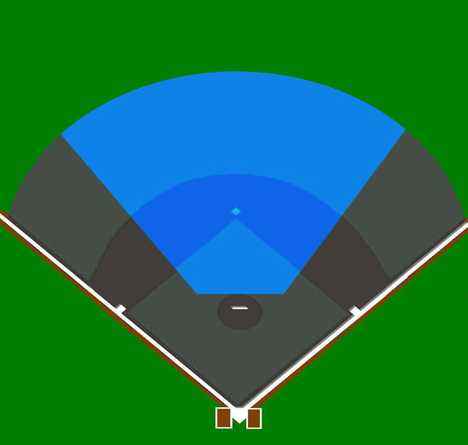
Fly Ball Coverage—With Runners on Base
Base Umpire
Plate Umpire
Notes:
Runner(s) on Base
Base Umpire:
You have responsibility for fly balls in the “V”. The “V” is defined by the V-shaped area formed by lines starting at the mound that run through the left fielder and the right fielder in what is considered their straight up alignment positions.
In other words if the left fielder, shortstop, rightfielder, or second baseman is moving toward the baseline on his side of the field, the ball is NOT in the “V” and belongs to the Plate Umpire.
Plate Umpire:
Has responsibility for all fly balls that are not in the “V”
REMEMBER - When the ball goes up in the air, the Umpires should communicate with each other who has the ball.

Slide 40
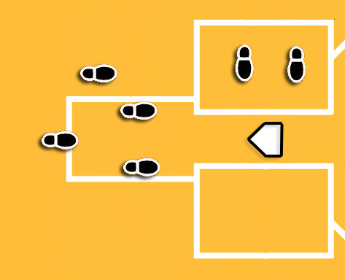
Working the Plate—The Box or Slot Stance, RH Batter
Back Line of
Catcher’s Heel
Slot
Heel/Toe
Relationship
The Proper Footwork
Notes:
Working the Plate
The Box or Slot Stance
Point slot foot toward pitcher
Don’t expose inside of slot leg
Position back foot at least 12 inches behind catcher’s heels
Work in slot with an exaggerated heel/toe relationship: the heel of your slot foot should be even with the toe of your back foot
Work with a wide base.
Bend at knees, not at waist.
Square up shoulders to pitcher.
Keep hands and arms in. Do not clinch fists. Keep your fingers loose to absorb the blow if the ball hits you.
Set up so that the bottom of your mask is at the top of the catcher’s head.
Square up your head to the pitcher. Eyes should be level.
Follow pitch with eyes, not your head.
Very important—set up aggressively into the pitch; i.e. your back is not perpendicular to the ground, but forward into the pitch.

Slide 41
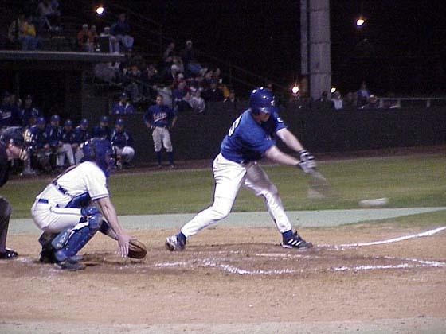
Working the Plate—Check Swing
Check Swing Mechanics
For a right handed batter, point with left hand at batter and have a right hand in strike motion
Verbalize, “Yes, He Went.”
For a left handed batter, point with your right hand, and then come up with the strike motion
Verbalize, “Yes, He Went.”
If the batter does not swing, stay down and verbalize, “Ball!”
Notes:
Check Swing Mechanics
For a right handed batter, point with left hand at batter and have a right hand in strike motion.
Verbalize, “Yes, He Went.”
For a left handed batter, point with your right hand, and then come up with the strike motion.
Verbalize, “Yes, He Went.”
If the batter does not swing, stay down and verbalize, “Ball”

Slide 42
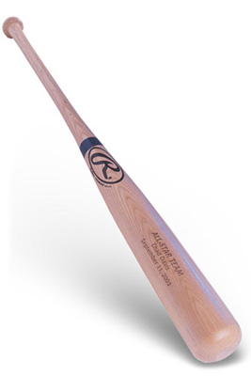
Working the Plate—Getting the Bat Away When the Batter Leaves the Bat in Home Plate Area
If possible, the umpire should get the bat away to prevent the runner from being hurt or stepped on by a player or umpire.
Remember, the play is your first priority. If you have time to get the bat away, do so.
In getting the bat, the umpire should keep his eyes on the ball, bend down and slide the bat along the ground away from the plate with his right hand.
Do not throw the bat because it may hit the on-deck batter, a runner, or the batboy.
Notes:
Getting the Bat Away When the Batter Leaves the Bat in Home Plate Area.
If possible, the umpire should get the bat away to prevent the runner from being hurt or stepped on by a player or umpire.
Remember, the play is your first priority. If you have time to get the bat away, do so.
In getting the bat, the umpire should keep his eyes on the ball, bend down and slide the bat along the ground away from the plate with his right hand.
Do not throw the bat because it may hit the on-deck batter, a runner, or the batboy.

Slide 43
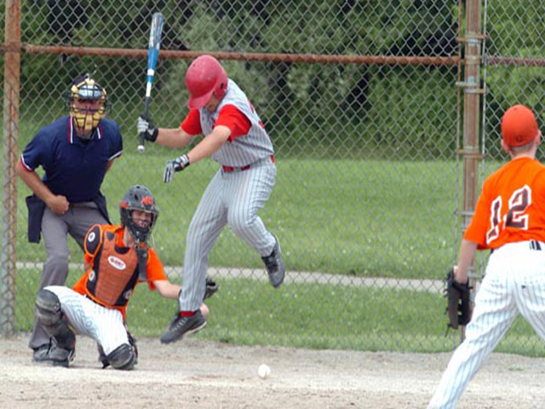
Working the Plate— Passed Balls and Wild Pitches
Pivot to the opposite side the ball goes, and let the catcher go after the ball. For a play back at the plate, be sure you are at the opposite side of the plate from the ball
Notes:
Passed Balls and Wild Pitches
Pivot to the opposite side the ball goes, and let the catcher go after the ball. For a play back at the plate, be sure you are at the opposite side of the plate from the ball

Slide 44
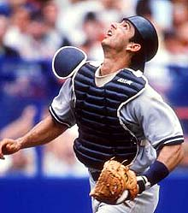
Working the Plate—Pop-Ups Behind the Plate
Pivot and let the catcher go after the ball, staying 12-16 feet away so you don’t interfere.
If the ball is near the fence, be sure to get a line of sight between the catcher and the fence and watch for interference or the catcher trapping the ball on the fence.
If the pop-up would possibly come back toward fair territory, position yourself on a foul line or foul line extended to make the call.
Notes:
Pivot and let the catcher go after the ball, staying 12-16 feet away so you don’t interfere.
If the ball is near the fence, be sure to get to a position so that you can see between the catcher and the fence and watch for interference or the catcher trapping the ball on the fence.
If the pop-up would possibly come back toward fair territory, position yourself on a foul line or foul line extended to make the call.

